Slide 1
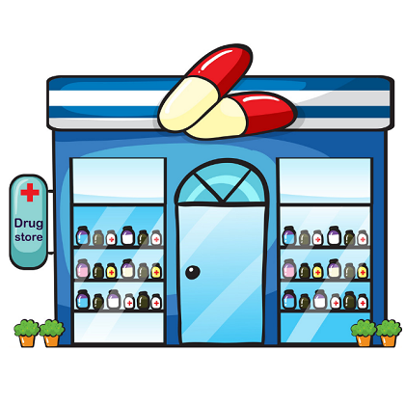
Online Medical Store

Slide 2
PROJECT NAME: LIFESERVEBD
COURSE NO: CSE 3224 COURSE NAME: Information System Design and Software Engineering Lab GROUP: B2
GROUP MEMBERS:
Tanima Islam (17.01.04.085)
Faiza Anan Noor (17.01.04.093)
Anika Bintee Aftab (17.01.04.098)
Mohana Rahman (17.01.04.101)

Slide 3

HOMEPAGE
Homepage will contain-
Image Slider
Best seller Items
Unique features
Footer
Header

Slide 4
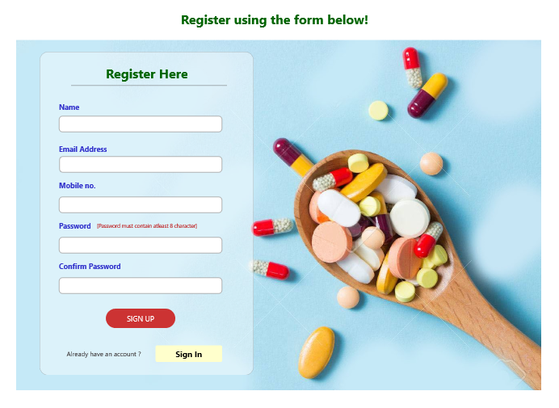

REGISTRATION
haven’t registered yet?
Fill up the form & follow the procedure.

Slide 5
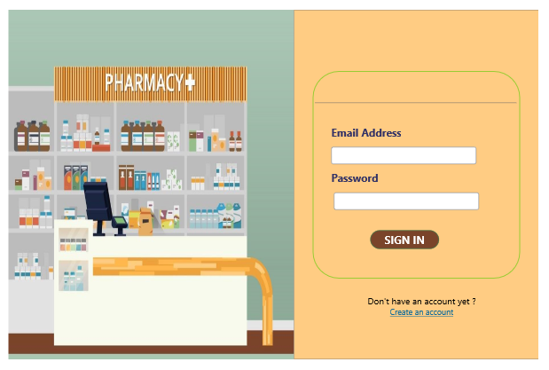

LOGIN
Login to enjoy our website…

Slide 6
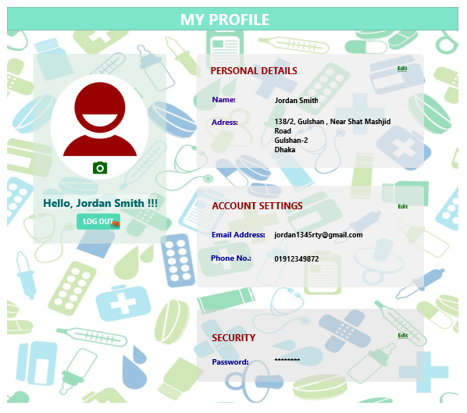
MY ACCOUNT
See Information
Edit Information
Upload Picture

Slide 7
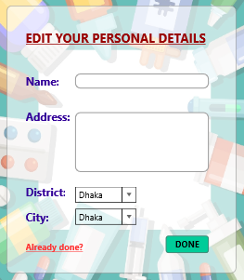
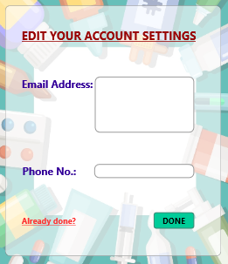
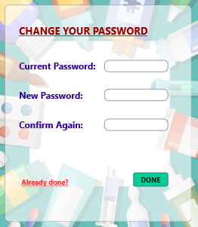
ACCOUNT EDIT
Edit Personal
Details
Edit Account
Information
Change
Password

Slide 8
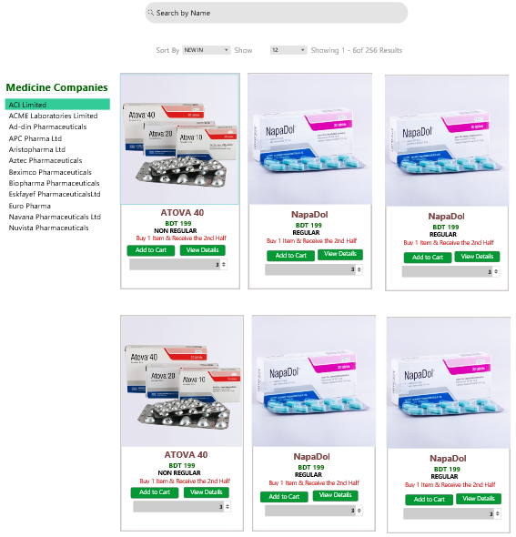
MEDICINE
User can search medicine by its name.
Medicines are sorted by in different orders.
By selecting each medicine, user can purchase them.
Different medicine companies can be selected by the user.
Two categories of medicine: regular & non regular.

Slide 9
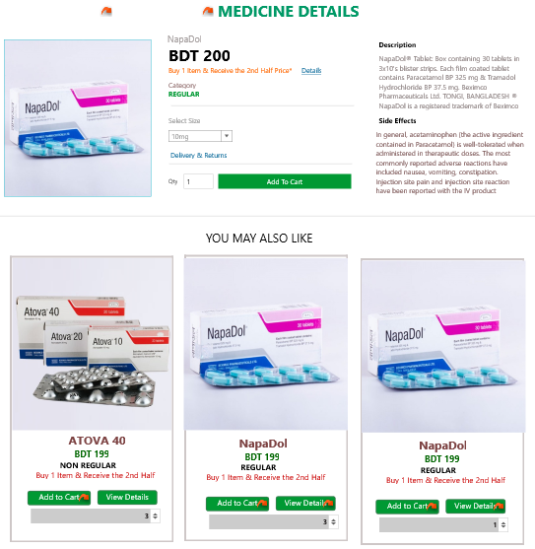
VIEW DETAIL
Medicine details contains-
Category
Size
Quantity
Description
Price
Side Effects

Slide 10
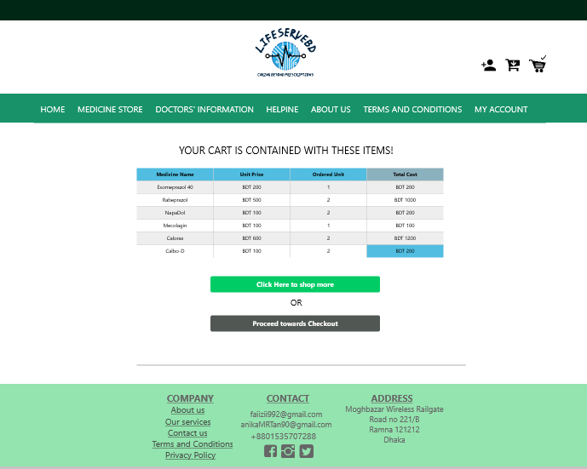
VIEW CART
Want to see Your Cart???

Slide 11
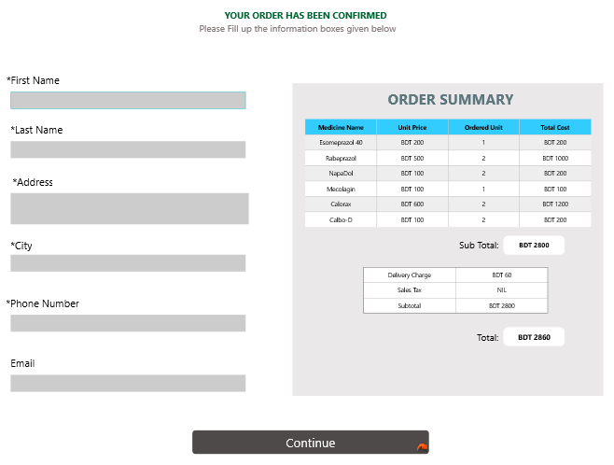
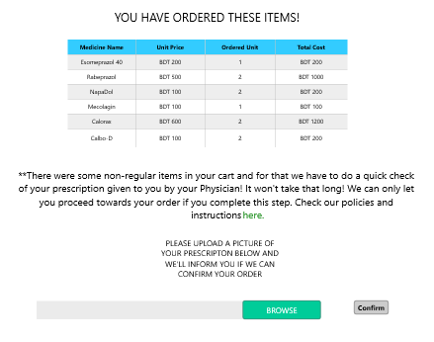

PLACE ORDER

Slide 12
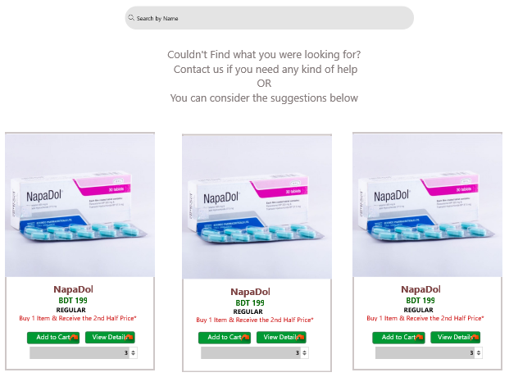
ALTERNATIVE MEDICINE
couldn’t find what you were looking for?
NO :’(
don’t worry! This is your alternate medicine.

Slide 13
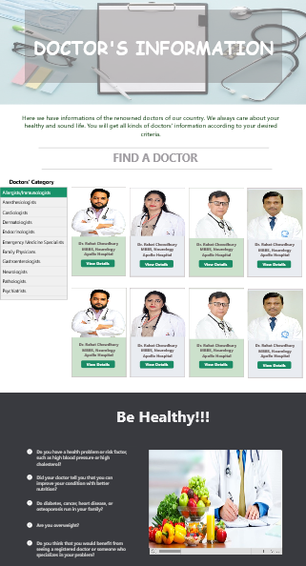
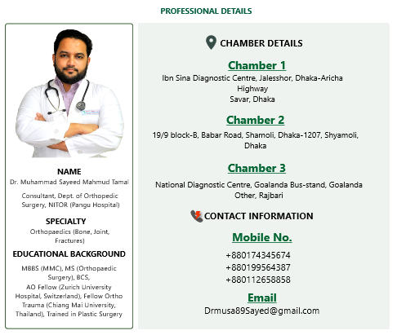
DOCTOR’S INFORMATION
Find renowned doctors according to your problem
Doctor’s
details will help
to reach the doctors

Slide 14
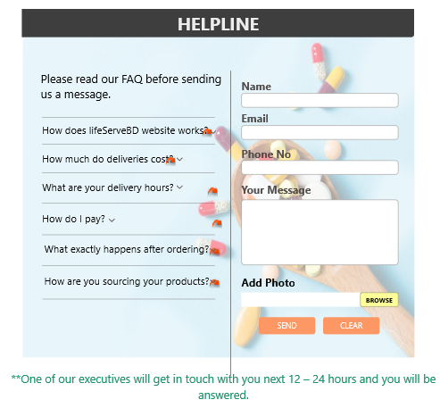
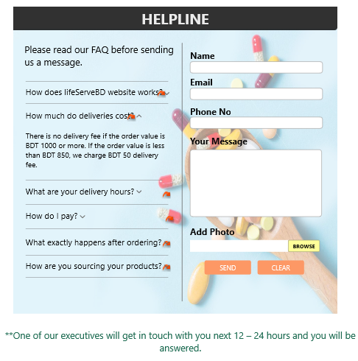
HELPLINE

Slide 15


TERMS AND POLICIES
Terms and conditions
Privacy policy

Slide 16
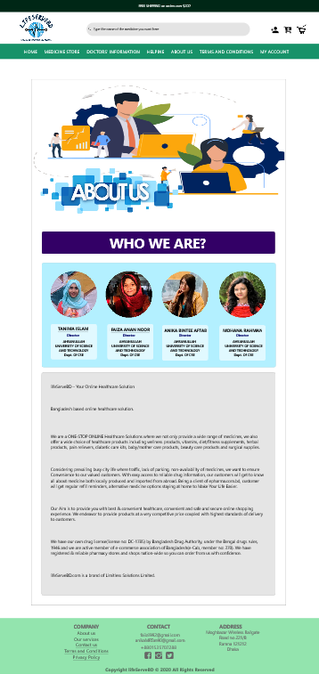
ABOUT US
Who we are
Company overview
History
Service we provide

Slide 17
Thanks!
Do you have any questions?

